Slide 1
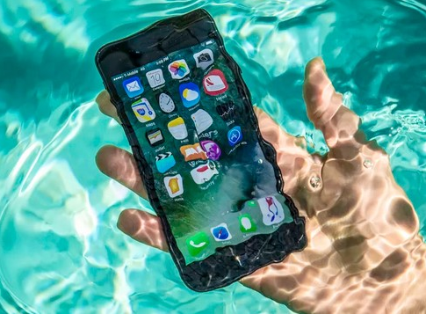
MARKETING PROMOTION
Hydrotech- The Waterproof Smartphone
Name:
Course ID:
Date:

Slide 2
Market introduction of a novel, waterproof smartphne brand
WHAT?
What’s the Promotion Idea?
A distinctive product based on water protective nanotechnology
WHY?
Targeting new consumer base to experience this outstanding product
HOW?

Slide 3
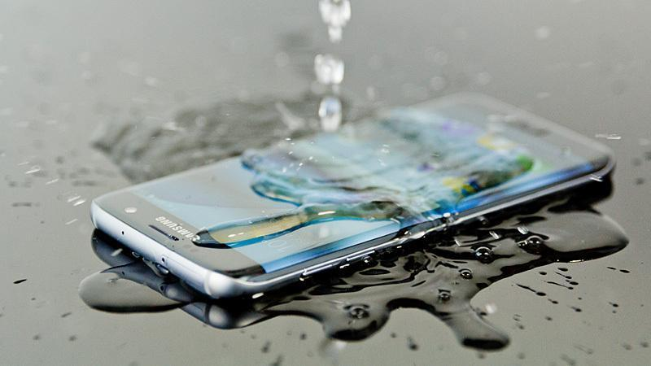
OVERVIEW
HYDROTECH AS A DISTINCTIVE BRAND
Hydtotech is a mobile technology brand that prides on the cutting edge water protective nanotechnology to offer sleek smartphone gadgets that fully provides protection from soda, coffee and water, among other liquids.
The product has market tested value and reflect not only superior quality but also total protection from water and other liquids.
It offers safety and reliability to the consumers.

Slide 4
CAMPAIGN’S GOALS & OBJECTIVES
1
To raise awareness about our unique brand of waterproof smartphone product with liquid protection as one of its salient features.
5
To earn more sales revenue arising from increased demand for the waterproof smartphone product
4
2
To grow the brand loyalty for our smartphone product from the current 5% to 6.5 percent
To effectively plan and execute a market campaign that would realize increased demand for the waterproof smartphone product
3
To target a new base of customers who have not heard before and used waterproof smartphone and create our brand visibility.

Slide 5
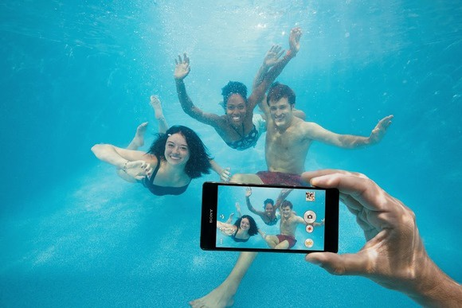
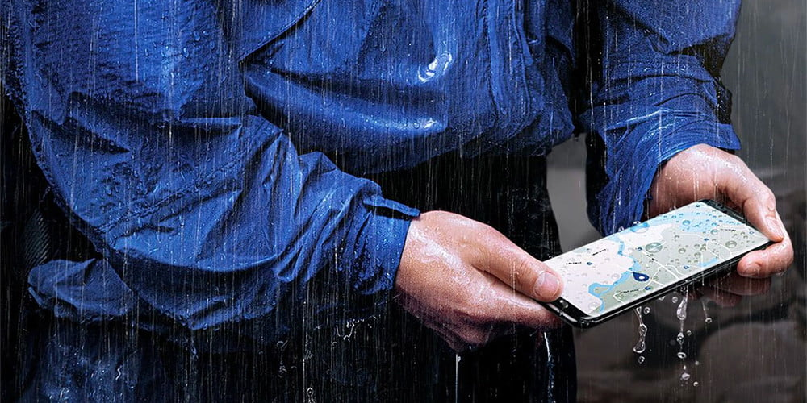
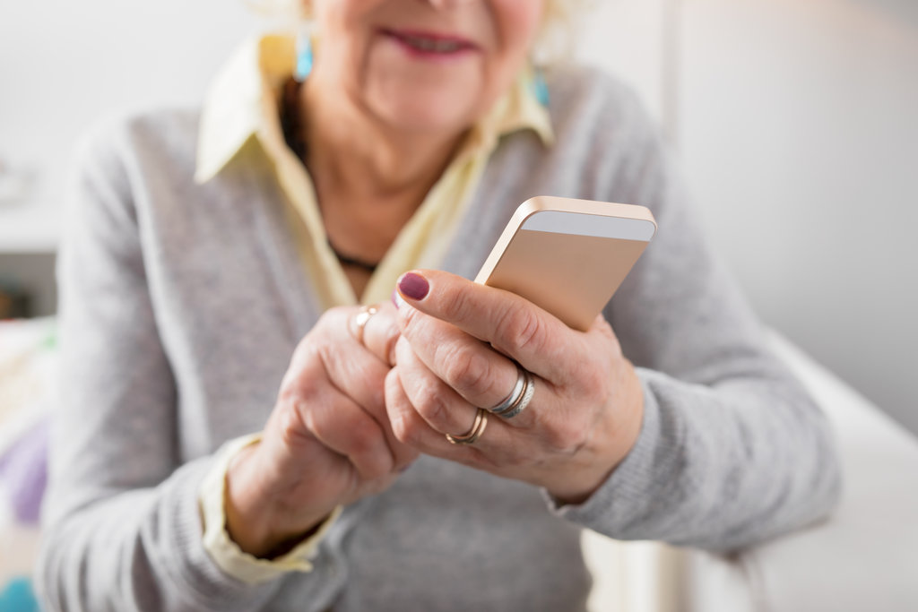
TARGET AUDIENCE
TEENS/YOUNG ADULTS
THE MIDDLE AGED
THE OLDER ADULTS
They are most intensive consumers of digital content and are enthusiastic about latest technological trends
Not too tech-savvy like youths but have a preference for the cost, convenience and safety of their gadgets
The product provides safety, especially with regard to falling into liquids.

Slide 6
MOST IMPORTANT THING TO SHOW
Our products defy any challenges regarding water, coffee or liquid spill.
While other smartphone brands are vulnerable to liquid spills, Hydrotech products are invincible and indifferent in such situation.
Therefore, the consumer is assured of a smartphone of a superior brand, having all other exciting features but undamaged by liquids.
NOTE HERE

Slide 7
HYDROTECH’S VALUES & MARKET POSITION
Safety
Simplicity
1
2
3
4
Style
Comfort
Our core values reflect our market positioning as a brand that provides solutions while giving consumers a special style in this unique product.
At Hydotech, it is not just enough to be different, but being different with style, comfort and safety for the smartphone gadget that one uses.

Slide 8

ROLE OF THE CREATIVE TEAM
1
To plan and implement a marketing program that is highly convincing to consumers and reflects the unique values embedded in the use of our brand
2
To present our waterproof smartphone technology as an attention-grabbing idea that has come to reality.
3
To always create “wow” moments in their creations offerin full persuasion for consumers to experience this produc.

Slide 9


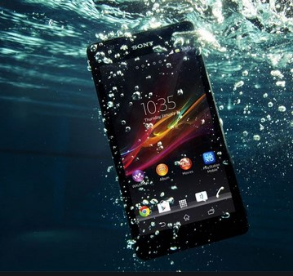
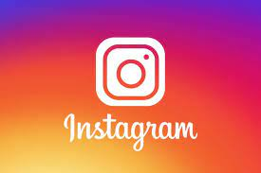

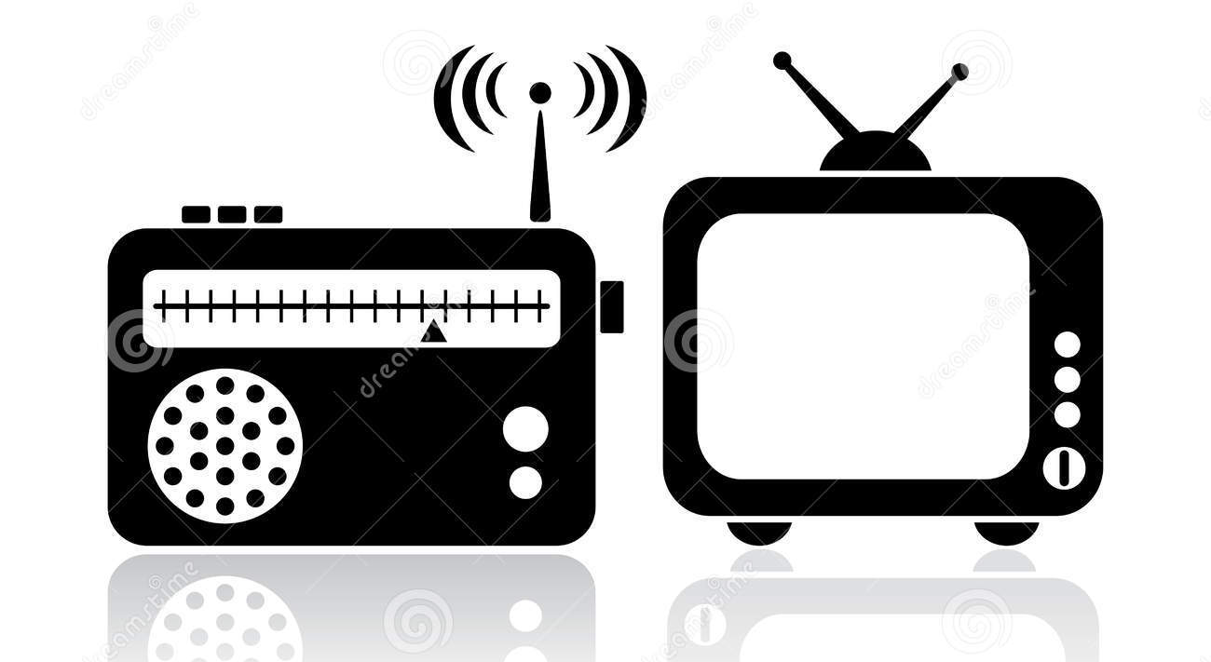
COMMUNICATION CHANNELS USED
1
2
3
4
4

Slide 10
CAMPAIGN SCHEDULE
Activity | Estimated Time
Planning phase for the ad | 3 weeks
Gathering Resources & logistics | 2 weeks
Shooting of the ad | 1 week
Post-production editing & refining | 2 weeks
Presenting the ad ready for running | Start of week 9
Estimated time for running the ad | 4.5 months

Slide 11
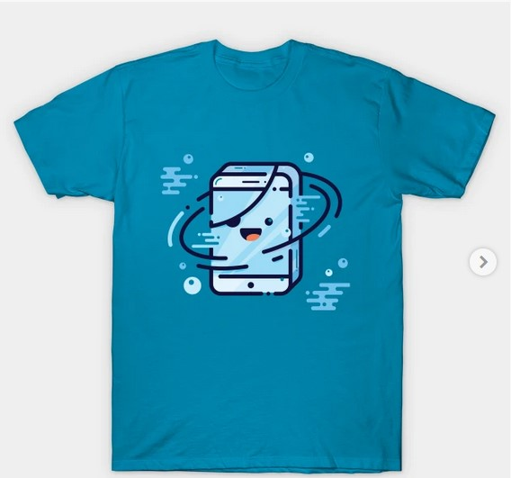
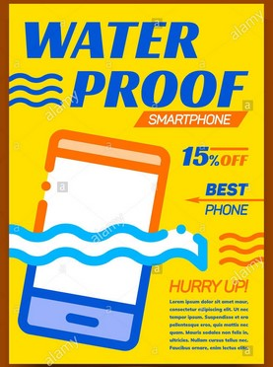
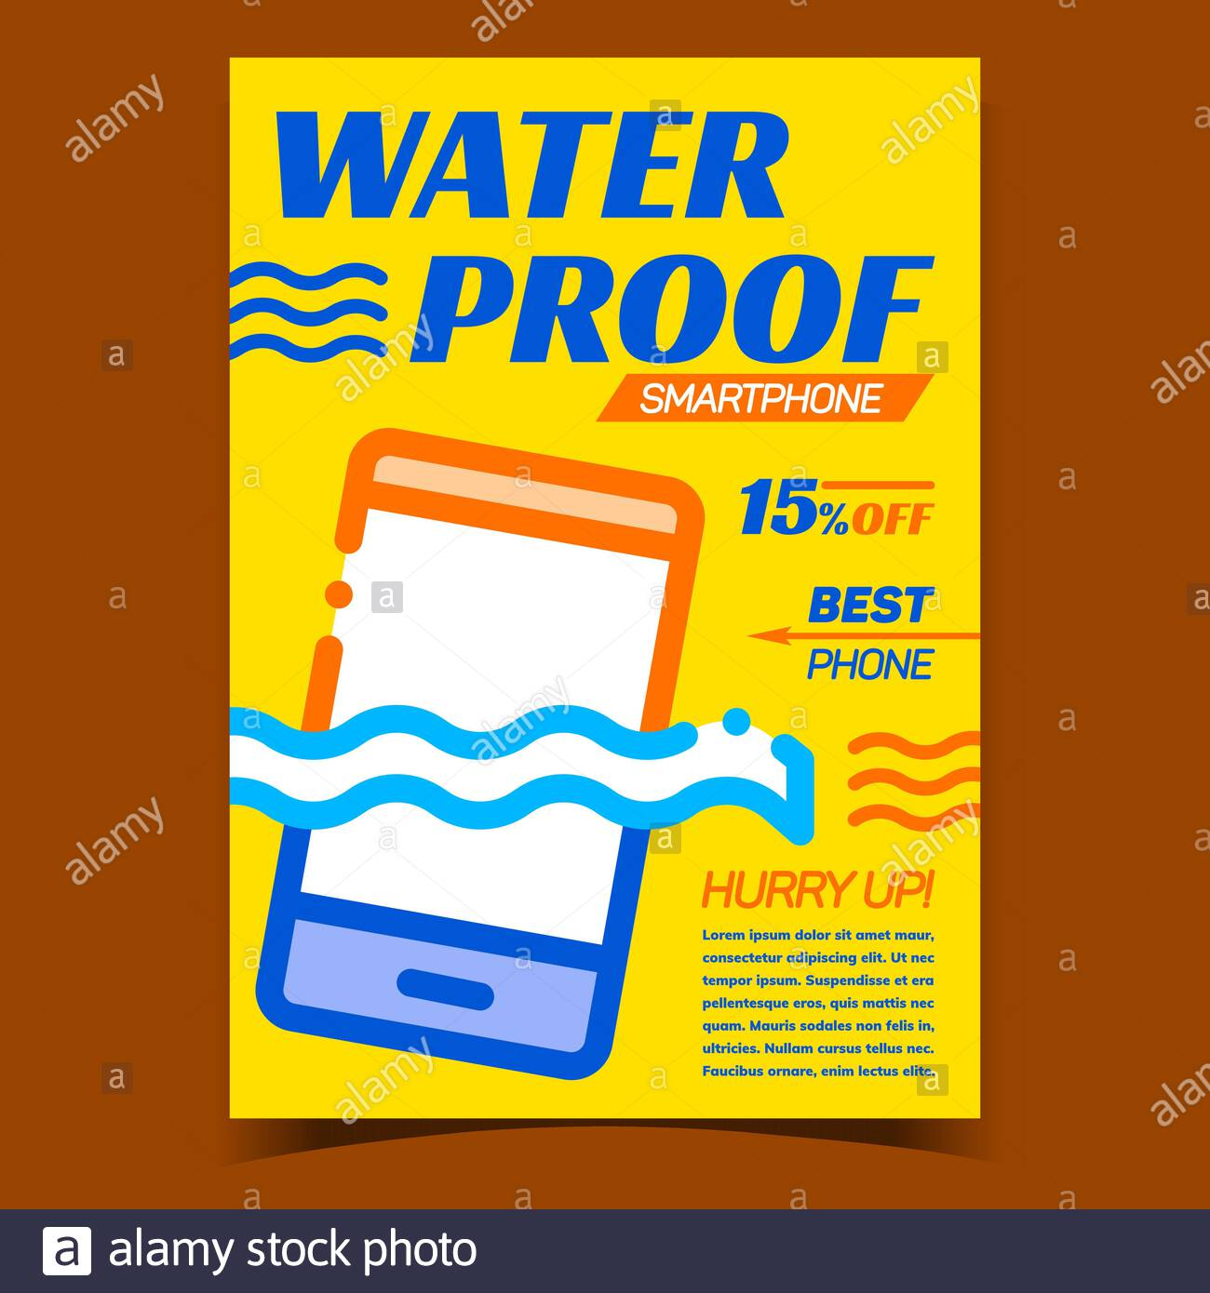
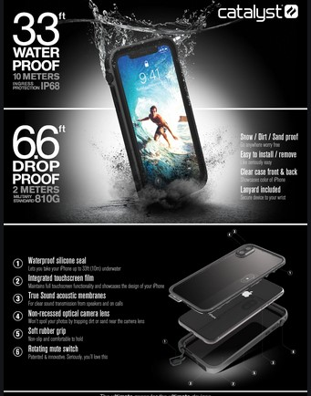
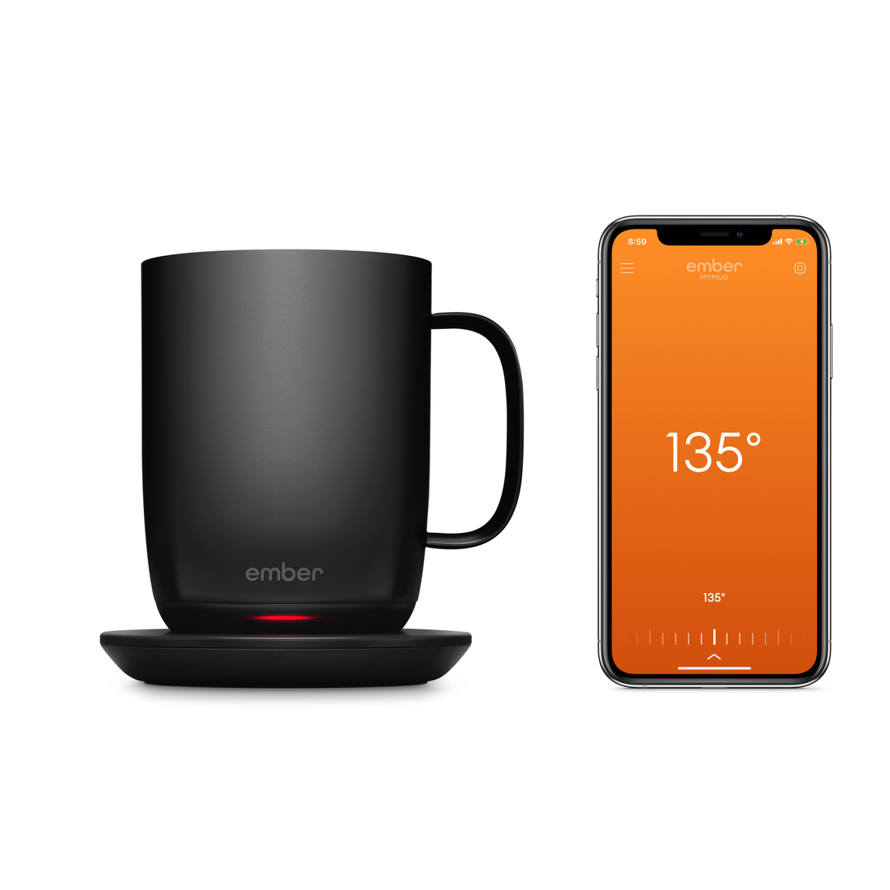
SUPPLEMENTAL MATERIALS
FLYERS
BRANDED TEE-SHIRTS
BANNERS
BRANDED COFFEE MUGS

Slide 12
REFERENCES
Dienlin, T., & Johannes, N. (2020). The impact of digital technology use on adolescent well-being . Dialogues in clinical neuroscience, 22(2), 135–142. Doi: 10.31887/DCNS.2020.22.2/tdienlin
Hzodev (2013). Waterproof Smartphones – The Next Step in Gadget Evolution. Retrieved on 6 June 2021 from https://www.hzo.com/blog/waterproof-smartphones-step-gadget-evolution/
Yu, Q., Xiong, R., Li, C., & Pecht, M. G. (2019). Water-resistant Smartphone Technologies. IEEE Access, 1–11. Doi:10.1109/access.2019.2904654
Wang, S., Bolling, K., Mao, W., Reichstadt, J., Jeste, D., Kim, H. C., & Nebeker, C. (2019). Technology to Support Aging in Place: Older Adults' Perspectives. Healthcare (Basel, Switzerland), 7(2), 60. Doi: 10.3390/healthcare7020060

